Slide 1

DEPARTMENT OF ELECTRONICS AND TELECOMMUNICATION ENGINEERING BHARATI VIDYAPEETH’S COLLEGE OF ENGINEERING FOR WOMEN ,PUNE-43 SAVITRIBAI PHULE PUNE UNIVERSITY , PUNE YEAR 2021-22
Problem Based Learning On : “Panic Alarm Circuit”
SUBMITED BY : SAKSHI SHIRKE(S190343135)
SHWETA SHIVALE(S190343137)
SHRUTI SINGH(S190343138)
RUCHITA UTTEKER(S190343144)
NAMRATA TOTAWAR(S190343143)
BHAGYASHRI ZENDE(S190343150)
Under the Guidance of : Prof . Varsha Karambelkar

Slide 2
Introduction
A well coordinated security system gives security personnel timely alert for action to be taken to save life and property from destruction.
Security systems should be built and placed at strategic locations
The security system built can be deployed in rural areas where we have less security personnel.
This system is utilized as a lowcost security system which is installed in various locations ranging from market places, stalls, supermarkets, street corners
The development of the system starts from the design stage of the system where instructions are programmed in a sequential manner.
The system starts from the ON state to the activation state to the state where readings are taken from the GPS module to the state where location is sent by the Arduino through the Wi-Fi module.

Slide 3
Literature Survey
Unfortunately, crime rates around the world increase every year. In particular, robberies in the streets are the events with the highest rate of occurrence. In addition, these types of events are not notified in a timely manner to the authorities.
Therefore, actions can not be carried out adequately. With the aim of contributing to this type of incidents can be notified to the authorities in a timely manner, the present document details the design and implementation of a prototype for a panic alert system.
Specifically, a server activated vigilance is designed and a smartphone application is implemented in order to report the theft events. In particular, the notification is sent to two different servers.
The person in distress sends the notification when press the lock/power button on the smartphone a certain number of times. The button activates a cluster of video cameras that share live feed to officials in both entities.

Slide 4
Problem Statement
To implement panic alarm circuit using 555IC

Slide 5
Objectives
A Panic Alarm Circuit is used to send an emergency signal immediately to the people in nearby location to call for help or to alert them. The possible panic situation can be any, it is not restricted to few situations.
One could possibly keep the push button at a hand reachable distance or comfortable place it to carry out quick action in silence by pressing a single button. The indication of emergency can either be in the form of visible or audible signal, which can be fixed at a few meters away through wire.

Slide 6
Methodology
The IC 555 is used in the Astable mode with the frequency depending on the values of resistors R2, R3 and C2. The values of R2 = 100KΩ, R3 = 22KΩ and C2 = 10µF.
After analyzing the ON and OFF time period of the panic alarm circuit given above, we find that the circuit will remain on for about 0.845 seconds and off for about 0.152 seconds.
The circuit is in the disabled mode when the button is not pressed and hence the alarm will not function when the button is not pressed. Although the power supply will be supplied to the IC 555 all the time, the circuit will operate in the astable mode only when the IC is enabled. The IC is in the enable mode only when pin 4 of the 555 IC is given a high voltage
This happens only when the button is pressed. The button can be made to have a plastic enclosure to have a better visibility and ease of access to it. For the purpose of demonstration, I have connected a simple Buzzer to the output of the 555 IC.

Slide 7
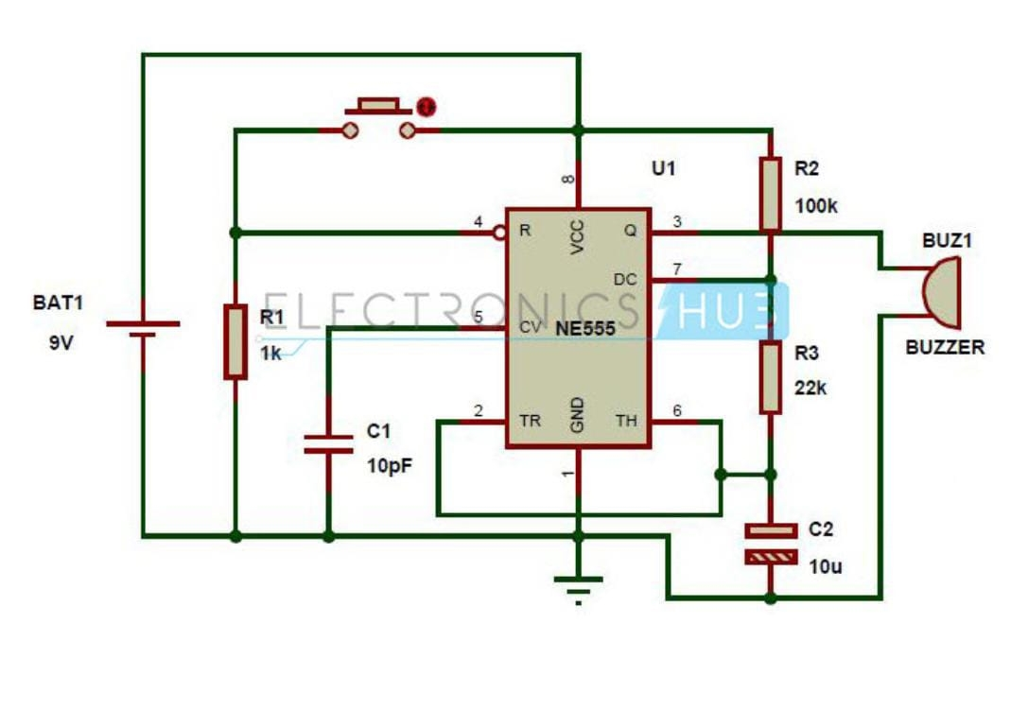
Circuit Diagram

Slide 8
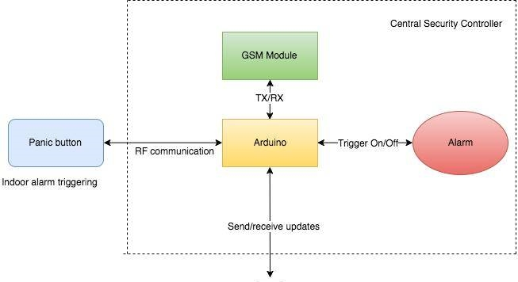
Block Diagram

Slide 9
Advantages
Constant Protection-
Appointing security guards or personally being there to protect the property 24/7 is practically not possible.
Strong Deterrent-
Homes and commercial properties that have burglar alarm systems installed are at a lesser risk of being targeted by intruders and burglars.
Uninterrupted Functionality-
There are two types of alarm systems. Wireless alarm systems work on batteries and not electricity. Which means they are effective during power-cuts as well.

Slide 10
Application
A button in a critical system (such as a nuclear weapons system) used to quickly activate an extreme measure to mitigate an emergency situation.
A red button integral to key fobs which activates a car alarm's siren.
A device given to elderly individuals in order to maintain their independence outside of an Aged Care Facility, while still affording them a means of summoning help should they require it .

Slide 11
References
https://www.communityresponsesystems.com/blog/panic-alarm/
Research Gate
Academia.edu

Slide 12
Thank you..

